Slide 1
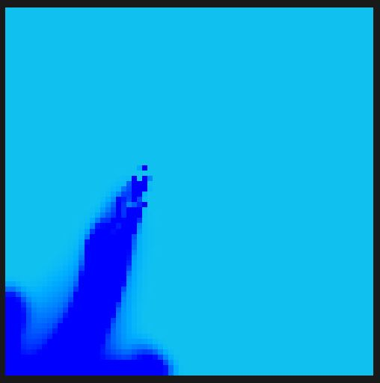
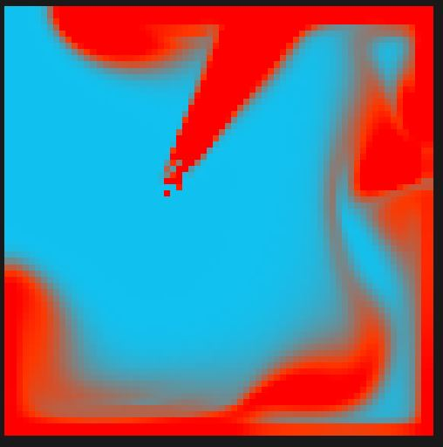
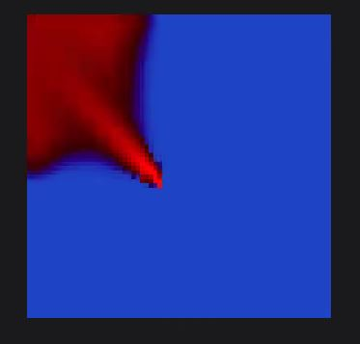
Stable Fluids
David Perrone
Jake Afonso

Slide 2





Presentation overview
Algorithm
Parallelization
Rendering
Demo

Slide 3
Background
Simulates a square of a fluid, with a defined viscosity and diffusion
Viscosity is the thickness of the fluid
Diffusion is how fast density spreads through the fluid
A “dye” is added at some point of the square with a given velocity
Dye moves throughout the fluid based on the fluid dynamics defined in the Navier-Stokes equations
Stable in the fact that there are no bounds on the time steps and the algorithms never “blow up”

Slide 4
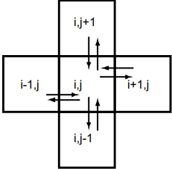
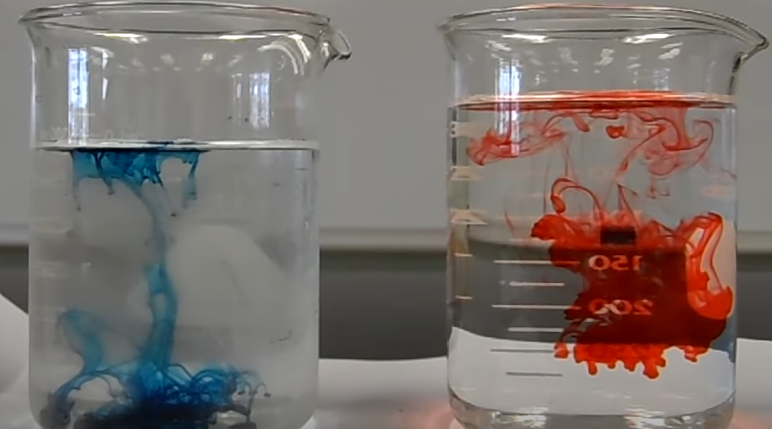
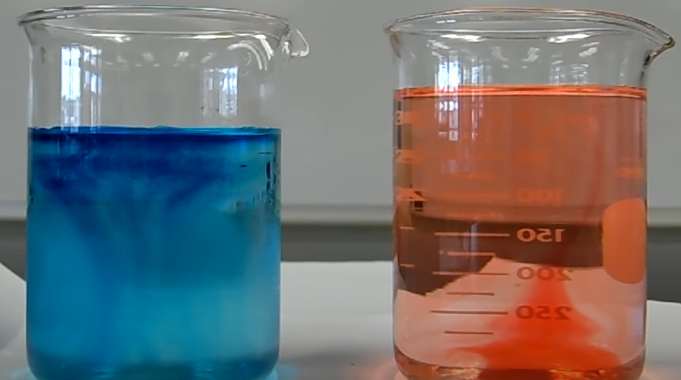
Diffusion
Represents the property of a dye spreading out throughout a fluid.
Happens for the dye itself and less obviously for the velocities of the fluid
Can happen differently based on the viscosity/diffusion value of the liquid
For example, putting dye in water will spread much faster than in molasses
For our simulation, velocity diffusion is based on the viscosity value and density diffusion is based on the diffusion value
Each particle exchanges density and velocity with its 4 direct neighbors
Start
End

Slide 5
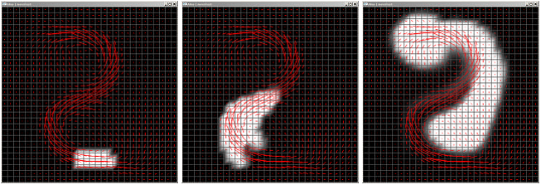
Advection
Represents the movement of the dye based on the velocity field within the fluid
If a liquid is moving, it will carry the dye in that direction as well
Similarly to diffusion, this happens for the dye and the velocities themselves
Advection carries the dye through the velocity field

Slide 6
Projection
This upholds the incompressible property of the fluid
The amount of fluid coming into the square must equal the amount of fluid leaving the square
The other 2 functions mess with the equilibrium of the fluid, and project cleans it up after

Slide 7
Subroutines
Linear Solve
All 3 of these functions are based on approximating a solution to a linear system
Implements the Gauss-Seidel method → iterative solver
Set bnd
These functions all only deal with the inner part of the square
Set boundary sets the edges to be the opposite of the neighboring inner particle
Gives the effect of bouncing off the walls

Slide 8
Parallelization
Used cuda to implement a parallel version of the simulation
Defined num_threads/num_blks to have each thread be assigned a single particle
Diffuse, advect, and project functions into __global__ functions to launch as kernels
Lin_solve and set_bnd into __device__ functions to be called from within the kernels
Performed slower than serial for n < 6400 particles, but then started to outperform for n > 6400.
Overall close to constant time for increasing size, while serial was exponential

Slide 9
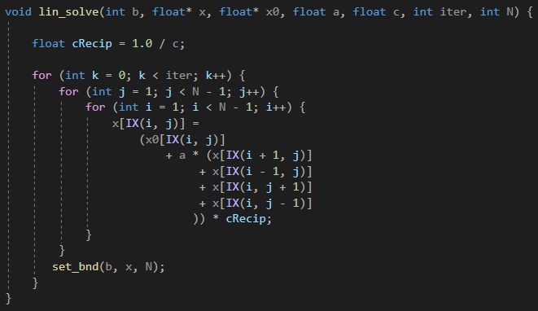
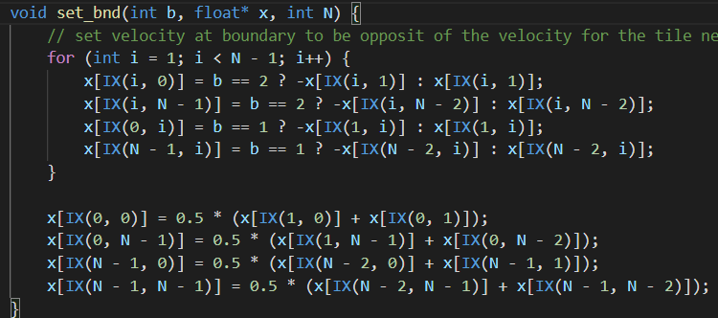
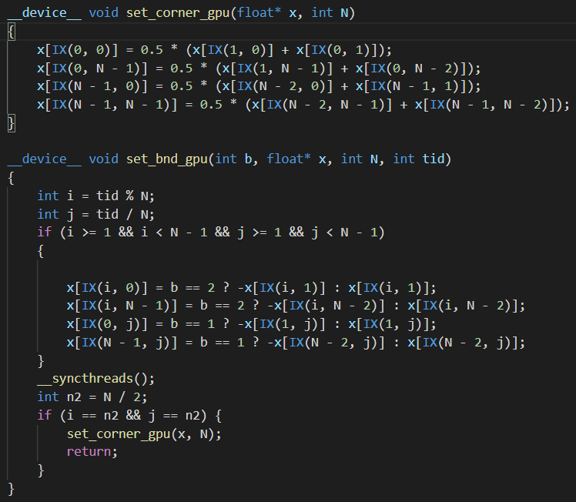
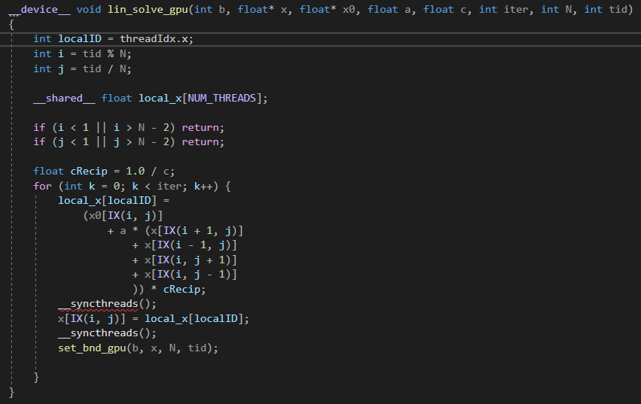
Serial:
Cuda:

Slide 10
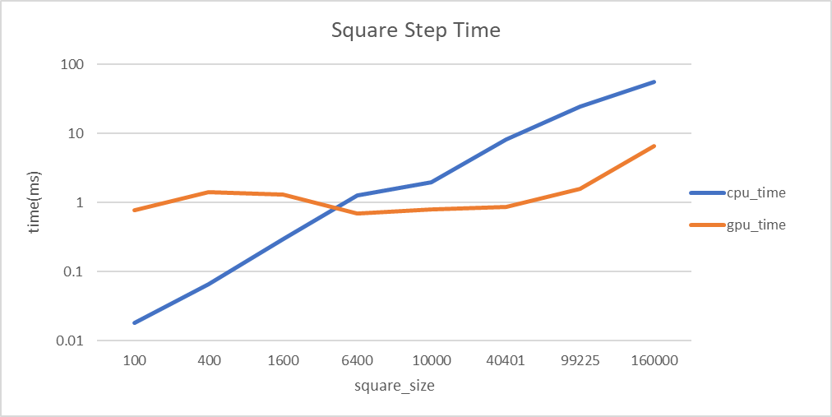
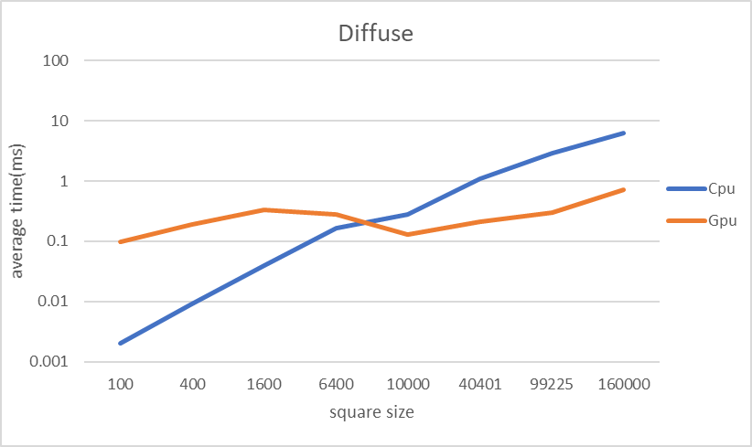
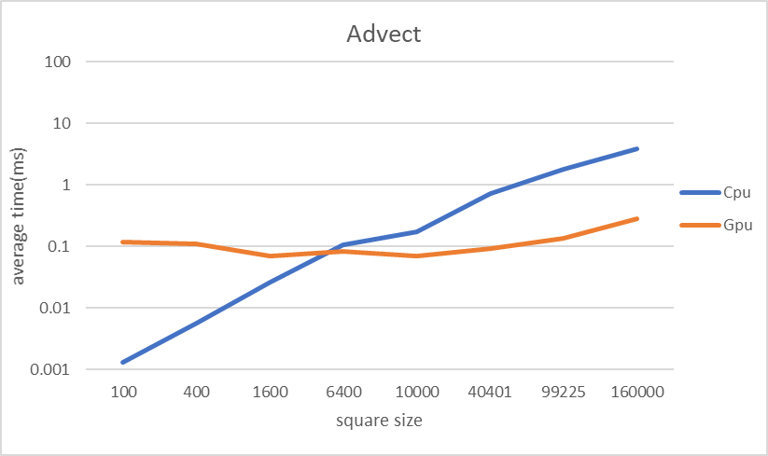
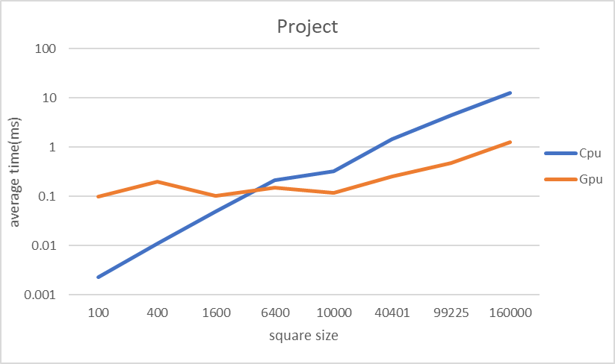

Slide 11
Rendering
Vertices
Instanced Rendering
Cuda OpenGL Interop
OpenGL Memory layout
Matrix Multiplication

Slide 12
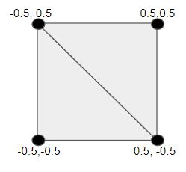
Rendering in OpenGL
The fluid square is made up of several smaller squares
Each square is rendered as two triangles
Multiply each vertex of the square with a transformation matrix to move/scale
The color within the square is represented by 4 floats (RGBA)

Slide 13
Instanced Rendering
1 draw call for 1000s of objects
Requires:
Shape vertices
Transformation matrices per instance
Colors per instance

Slide 14
Memory
Cuda performs the square calculations
Stores the location for each square
Stores the density (color) for each square
OpenGL renders the updated data each frame

Slide 15
Data Transfer
GPU
Cuda Memory
OpenGL Memory
Colors
Positions
CPU Memory

Slide 16
Rearranging the memory
Transformed
vertices
Color
vertices
Colors
Transformation
Matrices

Slide 17
Cuda - OpenGL Communication
Create CudaGraphicsResource
Create OpenGL Vertex Array Object
Create OpenGL vertex buffer - fill with 4 vertices of square
Create OpenGL Matrix Buffer
Register CudaGraphicsResource with Matrix Buffer
Create translation matrices, multiply with one scale matrix - store into Buffer
UnRegister Cuda
Repeat with OpenGL Color Buffer
NOTE: OpenGL and Cuda cannot use the same buffer simultaneously

Slide 18
Matrix Multiplication
Transformation Matrices
OpenGL Matrices
Scale Matrix

Slide 19
Demo (Mute Audio)

Slide 20
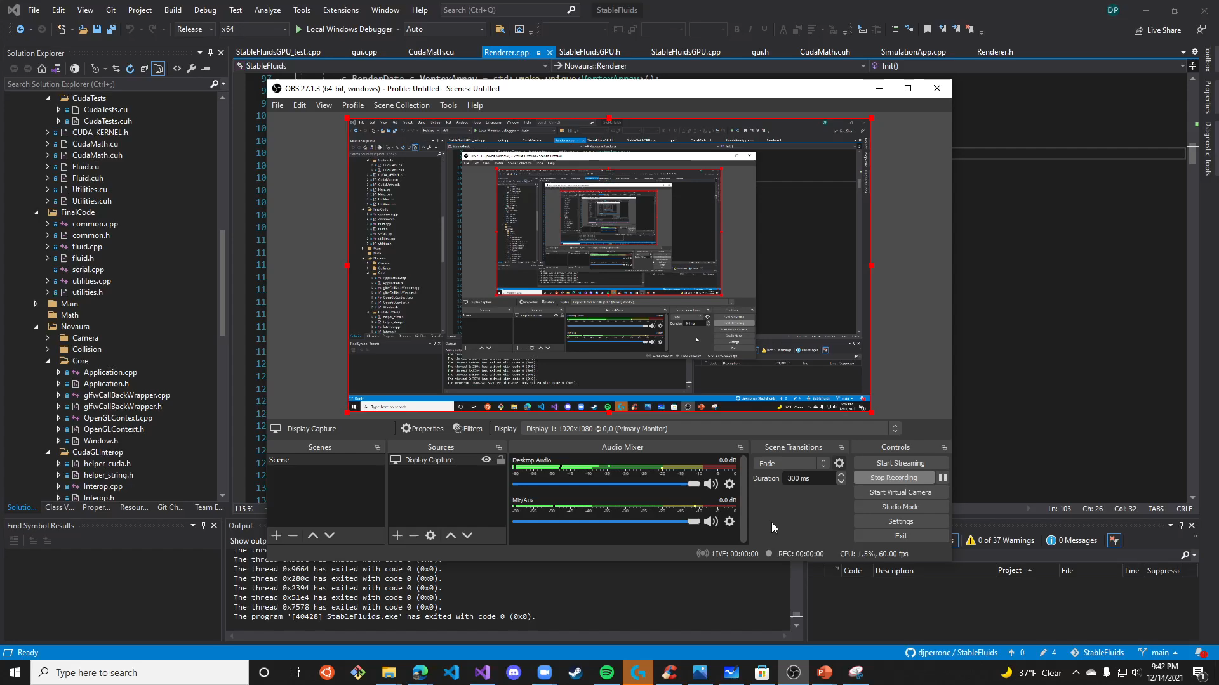

Slide 21
Questions?

Slide 22
Github
djperrone/StableFluids (github.com)

